Slide 1
NLP – Level-2 Training

Slide 2
AGENDA
Introduction
History of NLP
NLP Business Applications
Components of NLP
Various Libraries of NLP
Basic NLP Techniques
TF-IDF

Slide 3
Introduction
Organizations today deal with huge amount and wide variety of data – calls from customers, their emails, tweets, data from mobile applications, etc. It takes a lot of effort and time to make this data useful. One of the core skills in extracting information from text data is by using Natural Language Processing (NLP).
Natural language processing (NLP) is a field of artificial intelligence in which computers analyze, understand, and derive meaning information from human language in a smart and useful way.
By utilizing NLP, developers can organize and structure knowledge to perform tasks such as automatic summarization, translation, named entity recognition, relationship extraction, sentiment analysis, speech recognition, and topic segmentation.
NLP is characterized as a difficult problem in computer science. Human language is rarely precise or plainly spoken. To understand human language is to understand not only the words but the concepts and how they’re linked together to create meaning.
Despite the language being one of the easiest things for the human mind to learn, the ambiguity of language is what makes natural language processing a difficult problem for computers to master.
Notes:
https://www.xenonstack.com/blog/evolution-of-nlp/

Slide 4
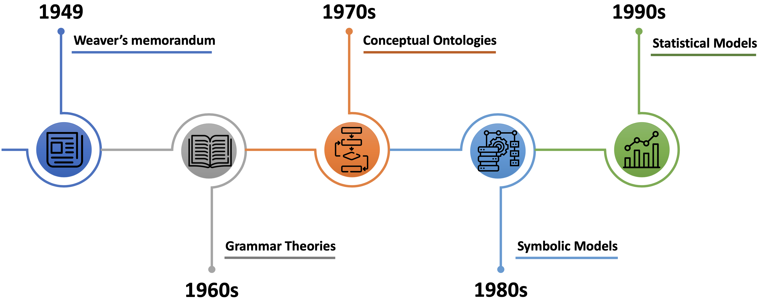
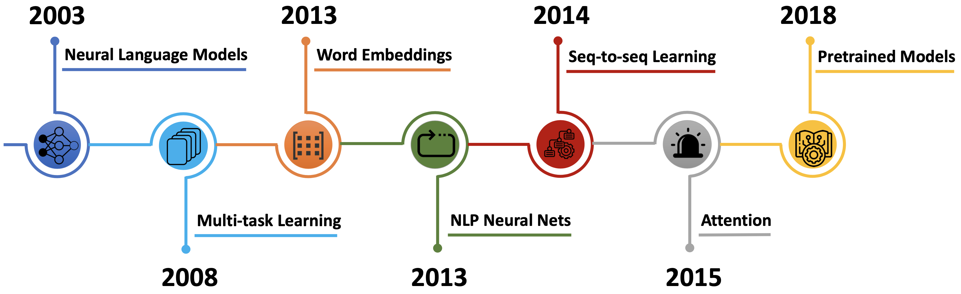
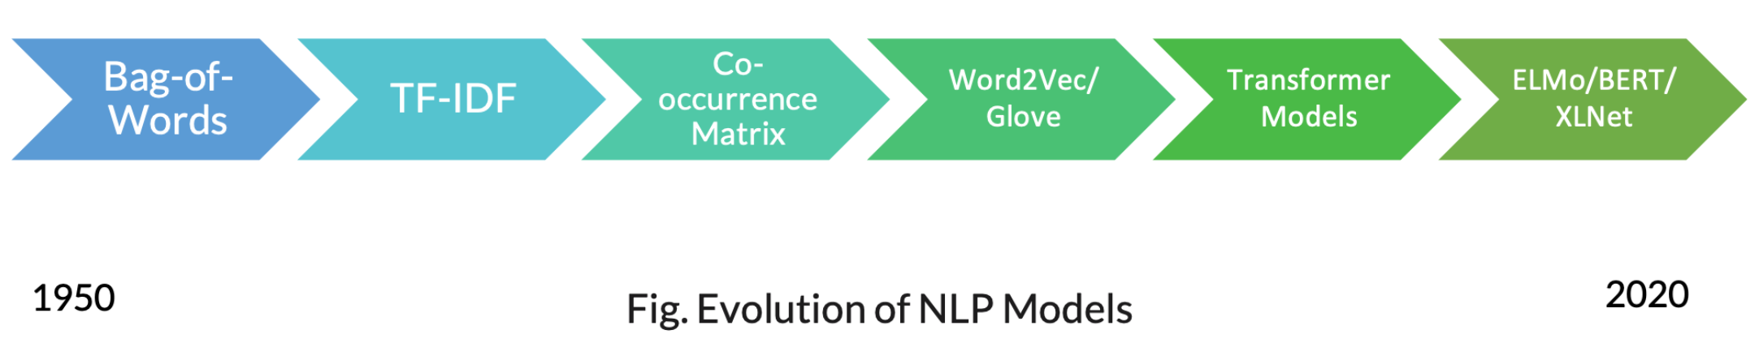
History of NLP
Notes:
https://medium.com/@antoine.louis/a-brief-history-of-natural-language-processing-part-1-ffbcb937ebce
https://medium.com/@antoine.louis/a-brief-history-of-natural-language-processing-part-2-f5e575e8e37
https://www.freshgravity.com/evolution-of-natural-language-processing/

Slide 5
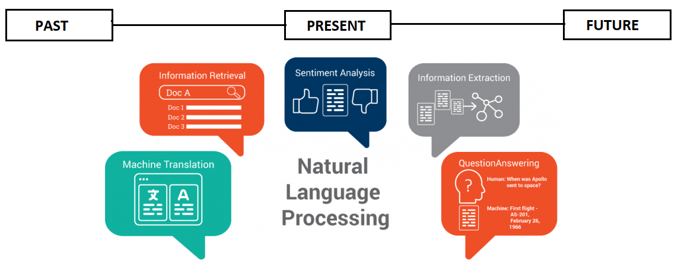
Evolution of NLP
Notes:
https://medium.com/@suneelpatel.in/nlp-guide-101-nlp-evolution-past-present-and-future-fcc573629da3

Slide 6
NLP Business Applications
Sentiment Analysis
Chatbots & Virtual Assistants
Text Classification
Text Extraction
Machine Translation
Text Summarization
Market Intelligence
Auto-Correct
Intent Classification
Speech Recognition
Notes:
https://monkeylearn.com/blog/natural-language-processing-applications/

Slide 7
Rule Based vs ML Based NLP
Rule Based | ML Based
Pros | Pros
Flexible Easy to debug Doesn’t require massive training corpus Understanding of language phenomenon High Precision | Easy to scale “Learnability” without explicitly programmed Fast development (if database is available) Understanding of language phenomenon High coverage
Cons | Cons
Requires skilled developers and linguists Slower development Moderate coverage | Requires training corpus with annotation Difficult to debug No understanding of language phenomenon
Notes:
https://medium.com/friendly-data/machine-learning-vs-rule-based-systems-in-nlp-5476de53c3b8

Slide 8
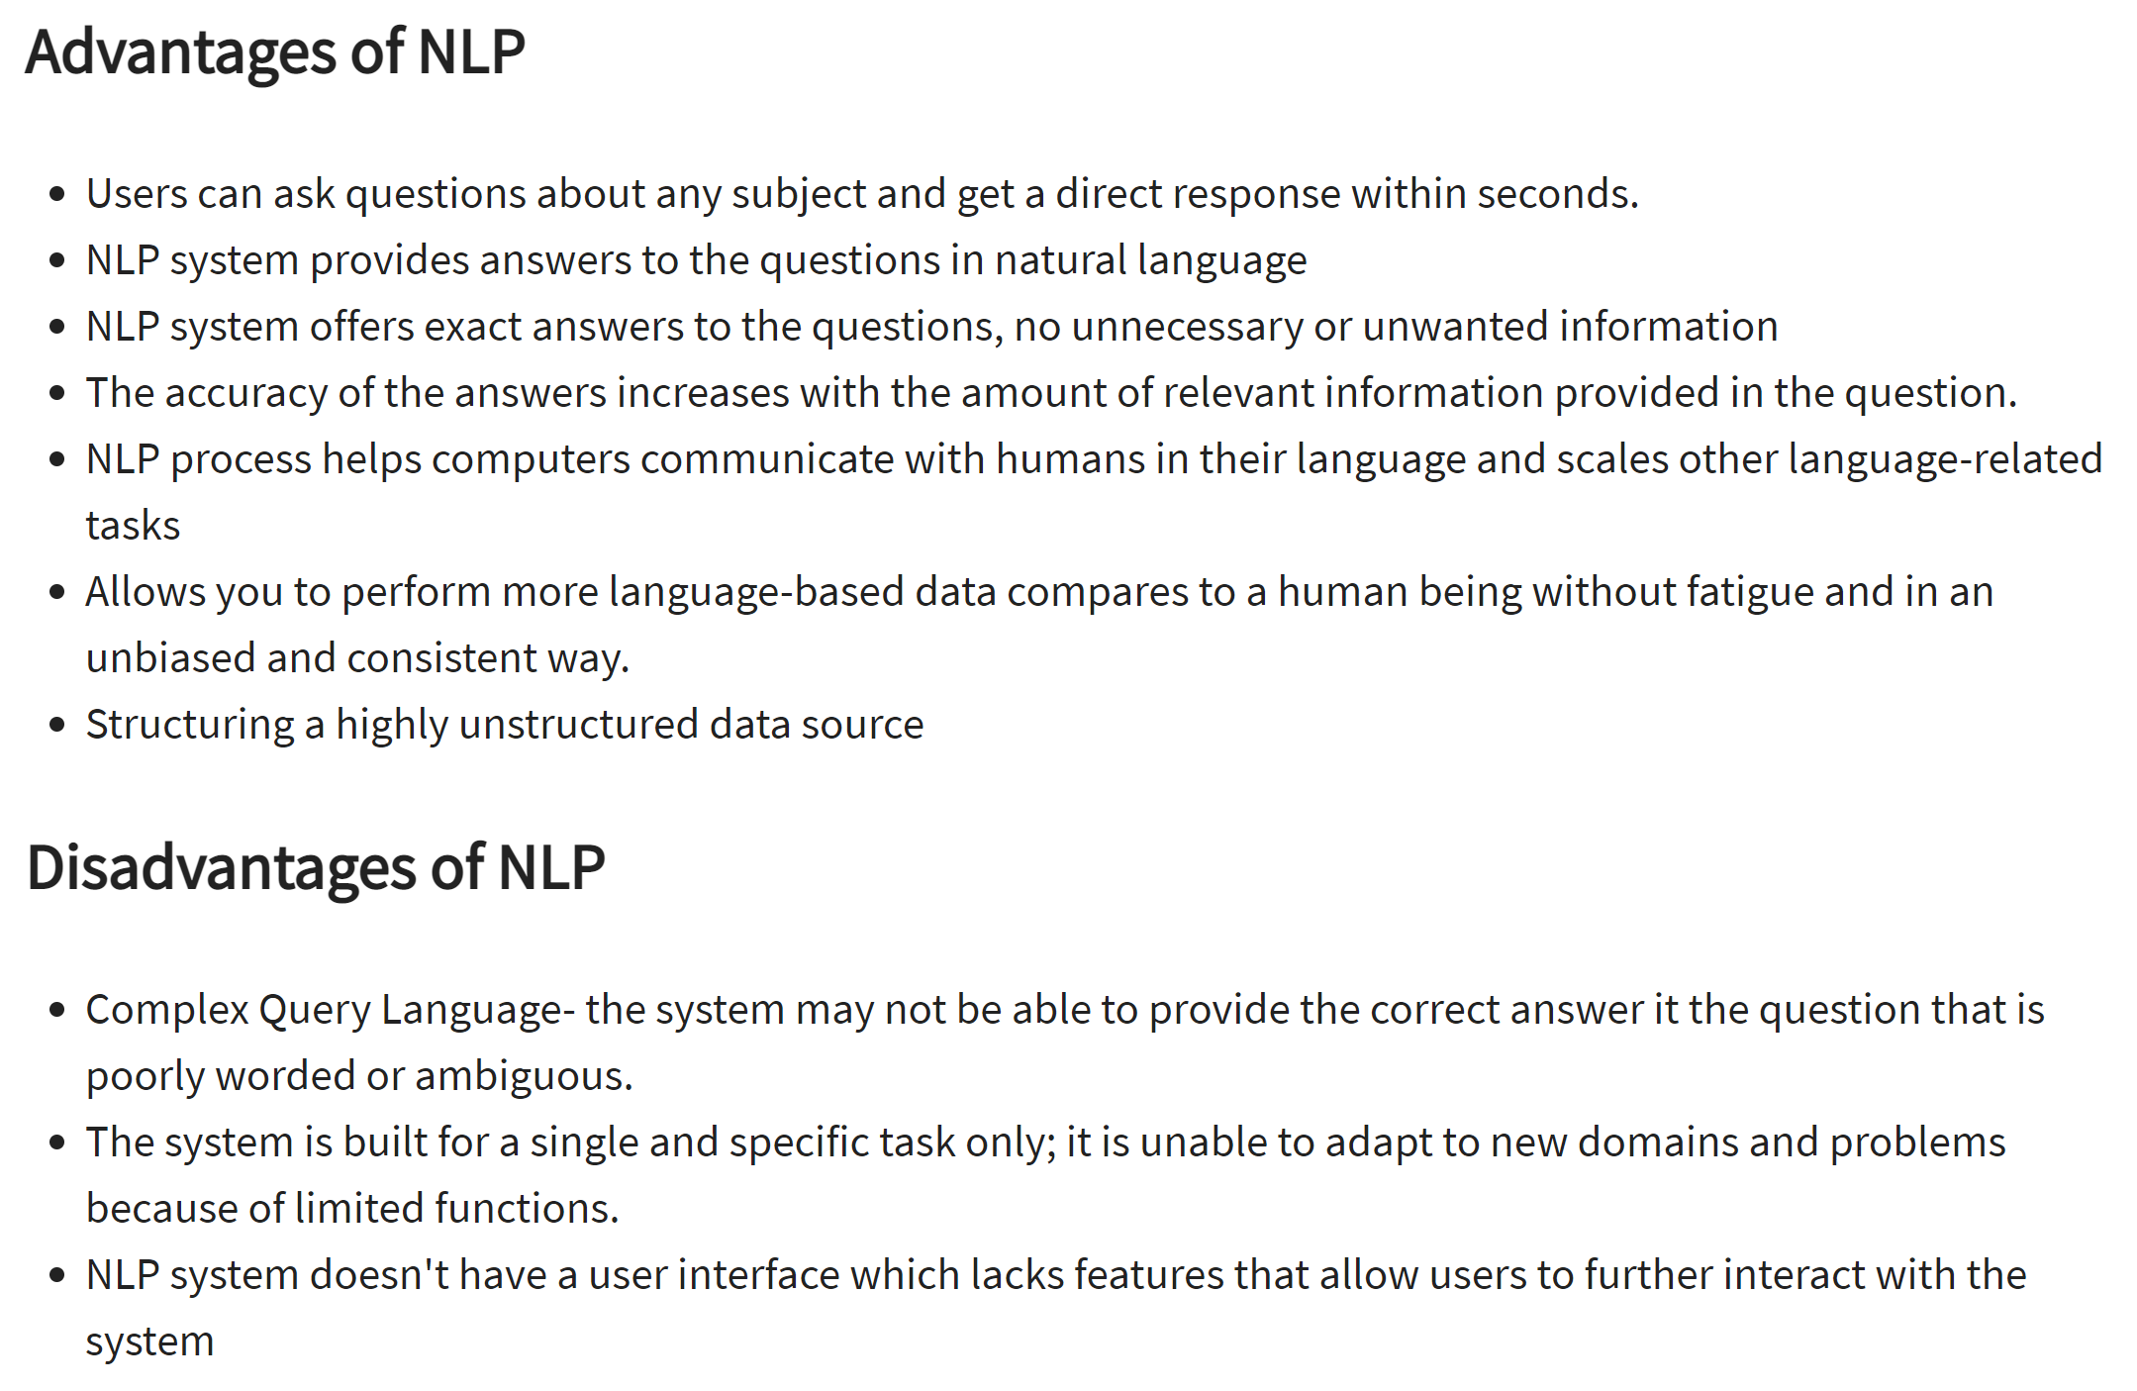
Pros and Cons of NLP
Notes:
https://www.guru99.com/nlp-tutorial.html

Slide 9
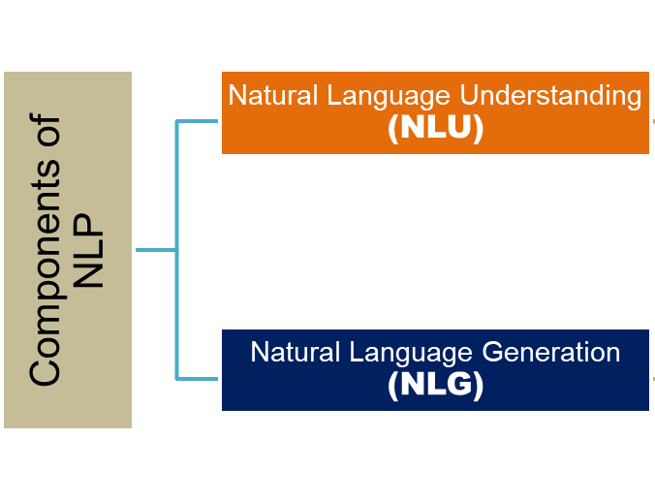
Components of NLP
NLP can be divided into two basic components:
Natural Language Understanding
Natural Language Generation
Notes:
https://datascience.foundation/sciencewhitepaper/natural-language-processing-nlp-simplified-a-step-by-step-guide
https://www.tutorialspoint.com/artificial_intelligence/artificial_intelligence_natural_language_processing.htmr.training/blogs/nlp-tutorial-natural-language-processing/
https://fintechxpert.com/2017/12/14/what-is-natural-language-processing/

Slide 10
Components of NLP (cont…)
1. Natural Language Understanding (NLU)
NLU is naturally harder than NLG tasks as there are lot of ambiguity while learning or trying to interpret a language
Typically all the NLU tasks, involve the below steps
Morphological Analysis
is defined as grammatical analysis of how words are formed by using morphemes(minimum unit of meaning)
Lexical Analysis
involves identifying and analyzing the structure of words and dividing the whole chunk of text into paragraphs, sentences, and words
Syntactic Analysis (Parsing)
involves analysis of words in the sentence for grammar and arranging words in a manner that shows the relationship among the words. The sentence such as “The school goes to boy” is rejected by English syntactic analyzer.
Semantic Analysis
draws the exact meaning or the dictionary meaning from the text. The text is checked for meaningfulness. It is done by mapping syntactic structures and objects in the task domain. The semantic analyzer disregards sentence such as “hot ice-cream”.
Discourse Integration
the meaning of any sentence depends upon the meaning of the sentence just before it. In addition, it also brings about the meaning of immediately succeeding sentence
Pragmatic Analysis
deals with outside word knowledge, which means knowledge that is external to the documents and/or queries and focuses on what was described is reinterpreted by what it actually meant, deriving the various aspects of language that require real world knowledge
Notes:
https://datascience.foundation/sciencewhitepaper/natural-language-processing-nlp-simplified-a-step-by-step-guide
https://www.tutorialspoint.com/artificial_intelligence/artificial_intelligence_natural_language_processing.htmr.training/blogs/nlp-tutorial-natural-language-processing/
https://fintechxpert.com/2017/12/14/what-is-natural-language-processing/

Slide 11
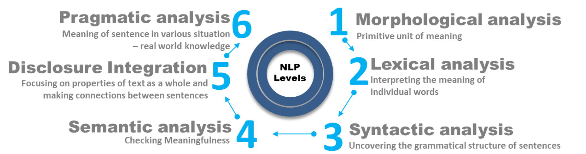
Components of NLP (cont…)
Notes:
https://datascience.foundation/sciencewhitepaper/natural-language-processing-nlp-simplified-a-step-by-step-guide
https://www.tutorialspoint.com/artificial_intelligence/artificial_intelligence_natural_language_processing.htmr.training/blogs/nlp-tutorial-natural-language-processing/
https://fintechxpert.com/2017/12/14/what-is-natural-language-processing/

Slide 12
Components of NLP (cont…)
2. Natural Language Generation (NLG)
It is the process of producing meaningful phrases and sentences in the form of natural language from some internal representation.
It involves :
Text Planning
includes retrieving the relevant content from knowledge base
Sentence Planning
means when we see more than one meaning in a sequence of words. It is also termed as grammatical ambiguity
Text Realization
is mapping sentence plan into sentence structure
Notes:
https://datascience.foundation/sciencewhitepaper/natural-language-processing-nlp-simplified-a-step-by-step-guide
https://www.tutorialspoint.com/artificial_intelligence/artificial_intelligence_natural_language_processing.htmr.training/blogs/nlp-tutorial-natural-language-processing/
https://fintechxpert.com/2017/12/14/what-is-natural-language-processing/

Slide 13
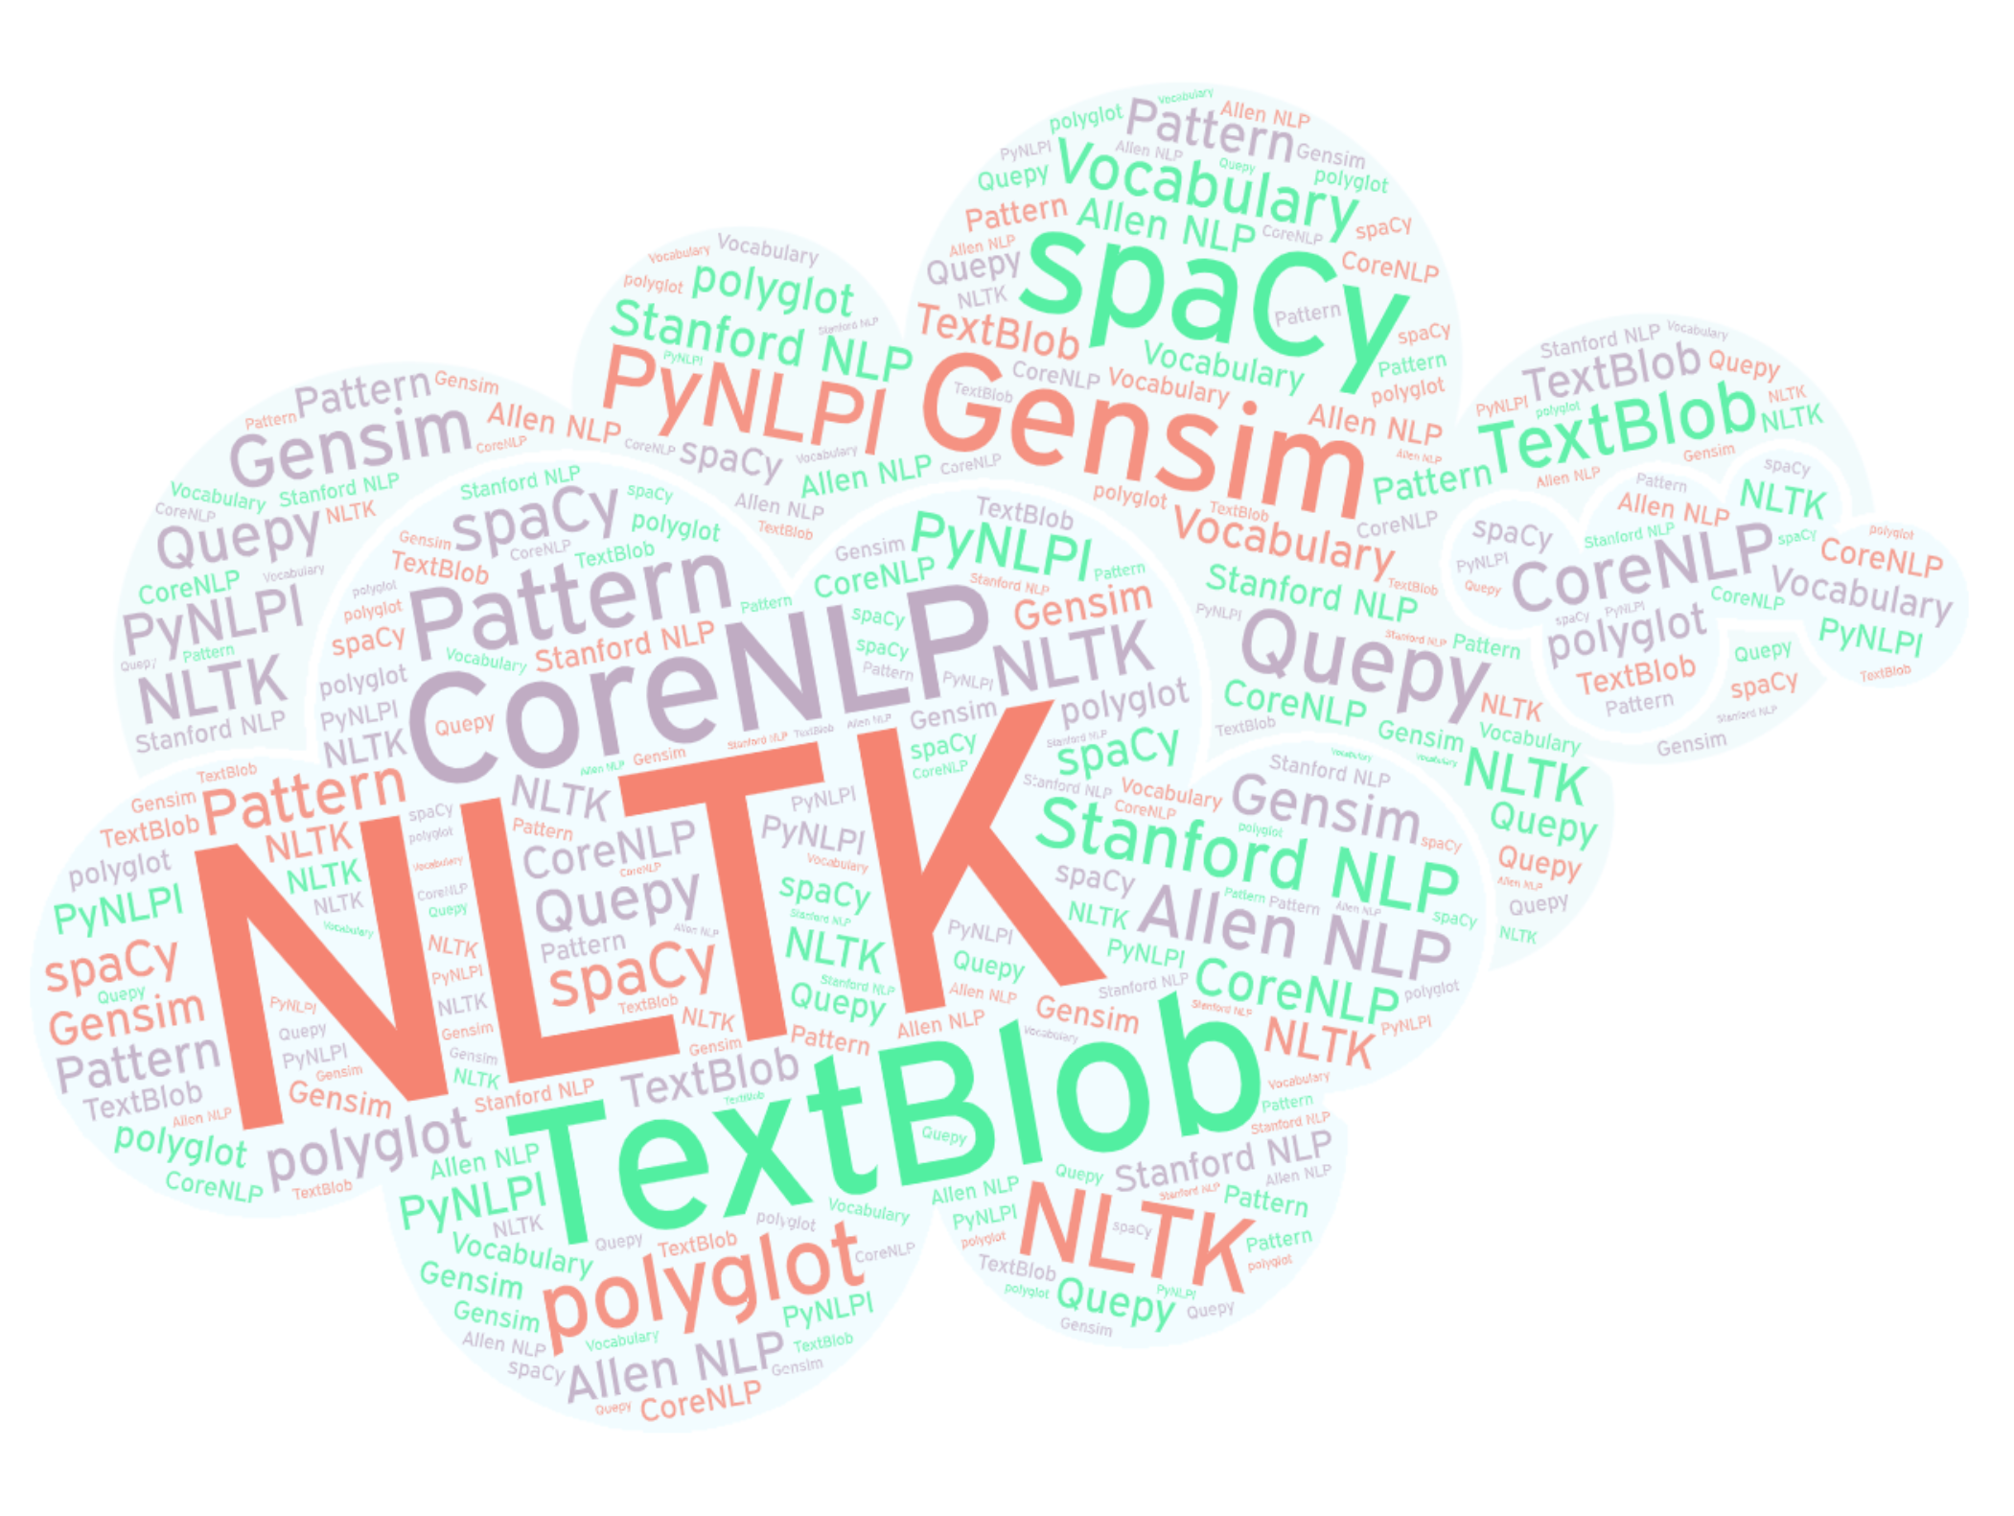
Various Libraries for NLP
Notes:
https://www.analyticsvidhya.com/blog/2017/01/ultimate-guide-to-understand-implement-natural-language-processing-codes-in-python/

Slide 14
Basic NLP Techniques
Basic NLP Techniques
Tokenization
Stemming
and Lemmatization
Part-Of-Speech (POS) Tagging
Chunking
Stop Word Removal
Named Entity Recognition
Notes:
https://heartbeat.fritz.ai/nlp-chronicles-intro-to-nlp-with-nltk-b2c369fbb9a7
https://towardsdatascience.com/a-practitioners-guide-to-natural-language-processing-part-i-processing-understanding-text-9f4abfd13e72

Slide 15
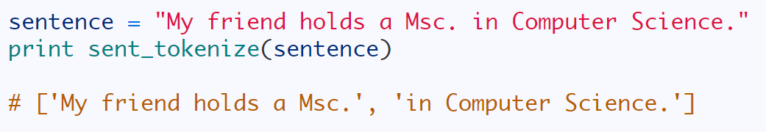
NLP Tech (conti…)
(a) Tokenization
Tokenization (also known as word segmentation) is the process of breaking text into smaller meaningful elements called tokens.
These so-called tokens can be words, numbers, or punctuation marks.
Tokenization is a crucial step in most NLP-related tasks. In most cases, it functions as a pre-processing step.
Since tokenization is relatively easy and uninteresting compared to other NLP tasks, it’s overlooked most of the time
However, errors made in this phase will propagate into later stages and cause problems.
Sentence Tokenization
is the process of tokenizing a text into sentences.
Word Tokenization
is the process of tokenizing sentences or text into words and punctuation.
Notes:
https://heartbeat.fritz.ai/nlp-chronicles-intro-to-nlp-with-nltk-b2c369fbb9a7
https://towardsdatascience.com/a-practitioners-guide-to-natural-language-processing-part-i-processing-understanding-text-9f4abfd13e72
https://nlpforhackers.io/splitting-text-into-sentences/

Slide 16
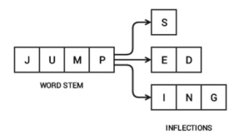
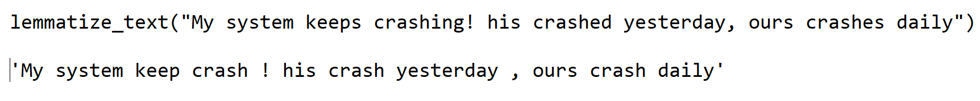
NLP Tech (conti…)
(b) Stemming and Lemmatization
both are used to reduce an inflected (or derived) word’s form to its root or base form
Stemming
is a heuristic process in which a word’s endings are chopped off in hope of achieving its base form
acts on words without knowing the context
is an imprecise science, if not done properly might lead to issues such as understemming and overstemming
Lemmatization
is a process that uses vocabulary and morphological analysis of words to remove the inflected endings to achieve its base form (dictionary form), which is known as the lemma
much more complicated and expensive process that requires an understanding of the context in which words appear in order to make decisions about what they mean
lexical vocabulary is used to derive the root form, is more time consuming than stemming, and is most likely to yield accurate results
Notes:
https://heartbeat.fritz.ai/nlp-chronicles-intro-to-nlp-with-nltk-b2c369fbb9a7
https://towardsdatascience.com/a-practitioners-guide-to-natural-language-processing-part-i-processing-understanding-text-9f4abfd13e72

Slide 17
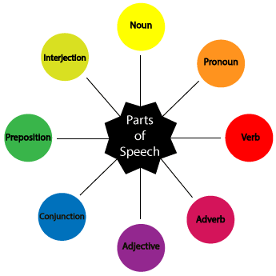
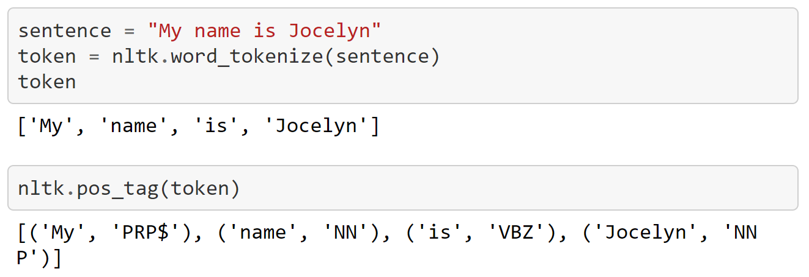
NLP Tech (conti…)
(c) Parts of Speech (PoS) Tagging
Part-Of-Speech tagging (or POS tagging) is also a very import component of NLP.
The purpose of the POS tagging is to assign labels for each token (a word in this case) with its respective grammatical component, such as noun, verb, adjective, or adverb. Most POS are divided into sub-classes.
POS tagging can be identified as a supervised machine learning solution, mainly because it takes features like the previous word, next word, and capitalization of the first word into consideration when assigning a POS tag to a word.
The most popular tag set for POS tagging is Penn Treebank tagset
Notes:
https://heartbeat.fritz.ai/nlp-chronicles-intro-to-nlp-with-nltk-b2c369fbb9a7
https://towardsdatascience.com/a-practitioners-guide-to-natural-language-processing-part-i-processing-understanding-text-9f4abfd13e72
https://medium.com/greyatom/learning-pos-tagging-chunking-in-nlp-85f7f811a8cb

Slide 18
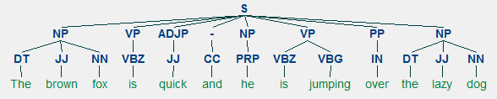
NLP Tech (conti…)
(d) Chunking
is a process that extracts phrases from a text sample
requires POS tagged input, and it provides chunks of phrases as output
Here we extract chunks of sentences that constitute meaning rather than identifying the sentence’s structure
This is different and more advanced than tokenization because it extracts phrases instead of tokens
Notes:
https://heartbeat.fritz.ai/nlp-chronicles-intro-to-nlp-with-nltk-b2c369fbb9a7
https://towardsdatascience.com/a-practitioners-guide-to-natural-language-processing-part-i-processing-understanding-text-9f4abfd13e72
https://medium.com/greyatom/learning-pos-tagging-chunking-in-nlp-85f7f811a8cb

Slide 19
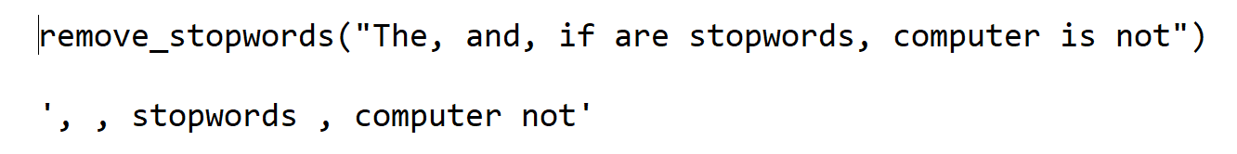
NLP Tech (conti…)
(e) Stop words Removal
Words which have little or no significance, especially when constructing meaningful features from text, are known as stopwords or stop words.
These are usually words that end up having the maximum frequency if you do a simple term or word frequency in a corpus.
Typically, these can be articles, conjunctions, prepositions and so on. Some examples of stopwords are a, an, the, and the like.
Notes:
https://heartbeat.fritz.ai/nlp-chronicles-intro-to-nlp-with-nltk-b2c369fbb9a7
https://towardsdatascience.com/a-practitioners-guide-to-natural-language-processing-part-i-processing-understanding-text-9f4abfd13e72

Slide 20
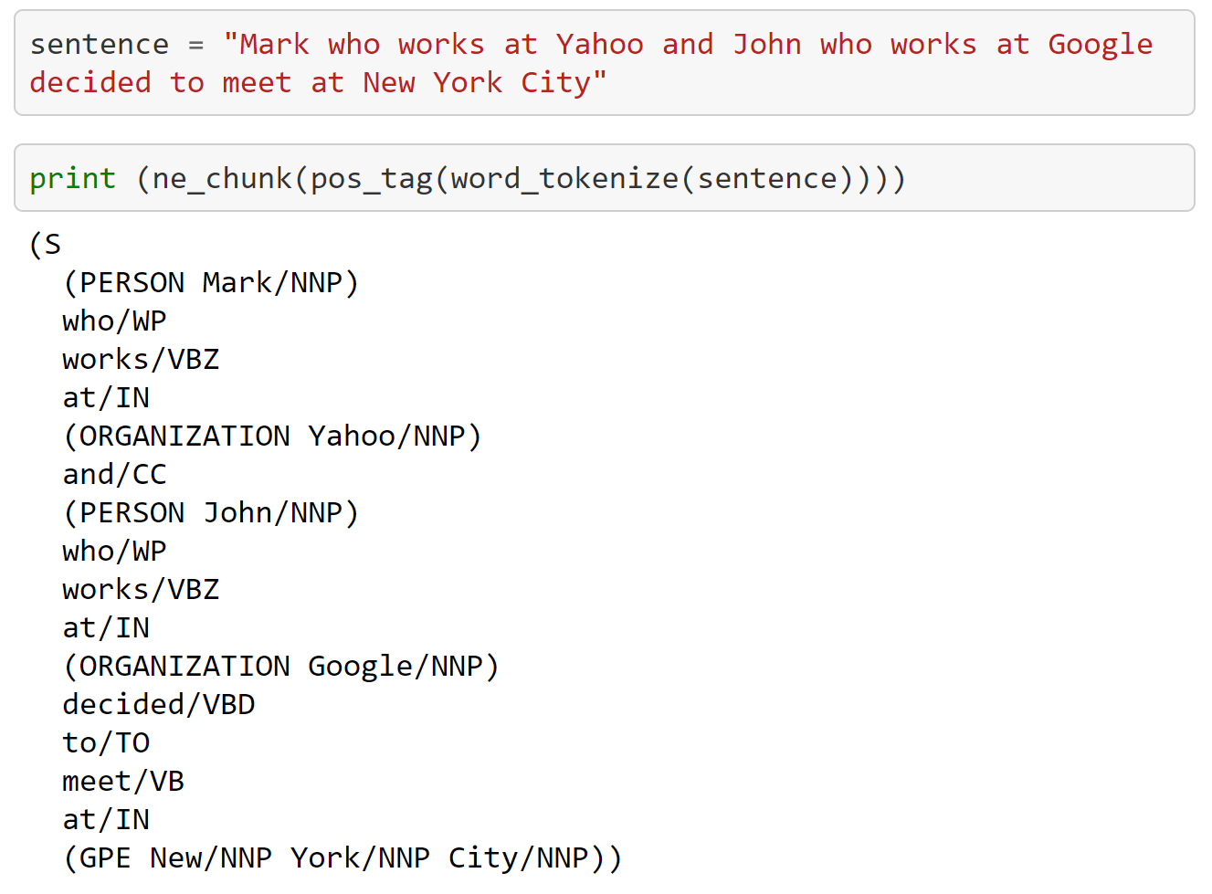
NLP Tech (conti…)
(f) Name Entity Recognition (NER)
Named Entity Recognition (NER), is the process of identifying entities such as Names, Locations, Dates, or Organizations that exist in an unstructured text sample.
The purpose of NER is to be able to map the extracted entities against a knowledge base, or to extract relationships between different entities.
Notes:
https://heartbeat.fritz.ai/nlp-chronicles-intro-to-nlp-with-nltk-b2c369fbb9a7
https://towardsdatascience.com/a-practitioners-guide-to-natural-language-processing-part-i-processing-understanding-text-9f4abfd13e72

Slide 21

Standard NLP Work Flow
Typically, any NLP-based problem can be solved by a methodical workflow that has a sequence of steps.
The major steps are depicted in the following figure
Depending on the problem at hand, we either focus on building predictive supervised models or unsupervised models, which usually focus more on pattern mining and grouping
Finally, we evaluate the model and the overall success criteria with relevant stakeholders or customers and deploy the final model for future usage.
Notes:
https://medium.com/@suneelpatel.in/nlp-pipeline-building-an-nlp-pipeline-step-by-step-7f0576e11d08

Slide 22
TEXT PRE-PROCESSING
In NLP, Text Preprocessing is the very first step.
It involves in transforming the text data prior to feeding it into the machine and there are lot of ways to do it.
Some of the steps involved in pre-processing text are:
Noise Removal
Remove whitespaces
Remove HTML tags
Convert accented characters
Remove special characters
Remove words/stop words
Tokenization
Normalization
Lowercasing characters
Numeric words to numbers
Stemming / Lemmatization
Notes:
https://www.analyticsvidhya.com/blog/2017/01/ultimate-guide-to-understand-implement-natural-language-processing-codes-in-python/
https://www.freshgravity.com/evolution-of-natural-language-processing/

Slide 23
Bag of Words (BoW)
Bag of Words(BoW) is a method of feature extraction with text data. This approach is a simple and flexible way of extracting features from documents.
A bag of words is a representation of text that describes the occurrence of words within a document
It just keep track of word counts and disregards the grammatical details and the word order
It is called a “bag” of words because any information about the order or structure of words in the document is discarded
The model is only concerned with whether known words occur in the document and not where in the document
BoW creation follows the below steps:
Tokenize the Sentences
Create a Dictionary of Word Frequency
Creating the Bag of Words Model
Notes:
https://stackabuse.com/python-for-nlp-creating-bag-of-words-model-from-scratch/
https://www.mygreatlearning.com/blog/bag-of-words/

Slide 24
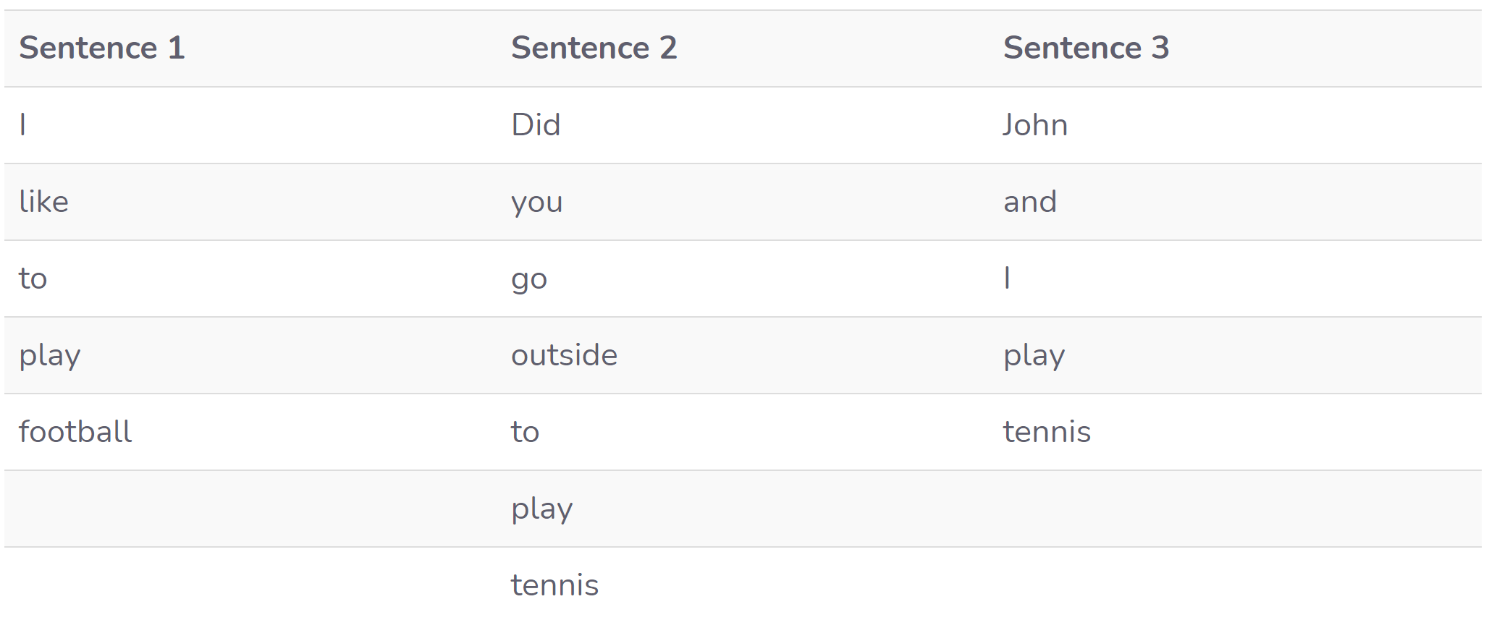
Bag of Words (cont…)
Step 1 : Tokenize the Sentences
Convert the sentences in our corpus into tokens or individual words
For example lets consider the below sentences
"I like to play football"
"Did you go outside to play tennis"
"John and I play tennis"

Slide 25
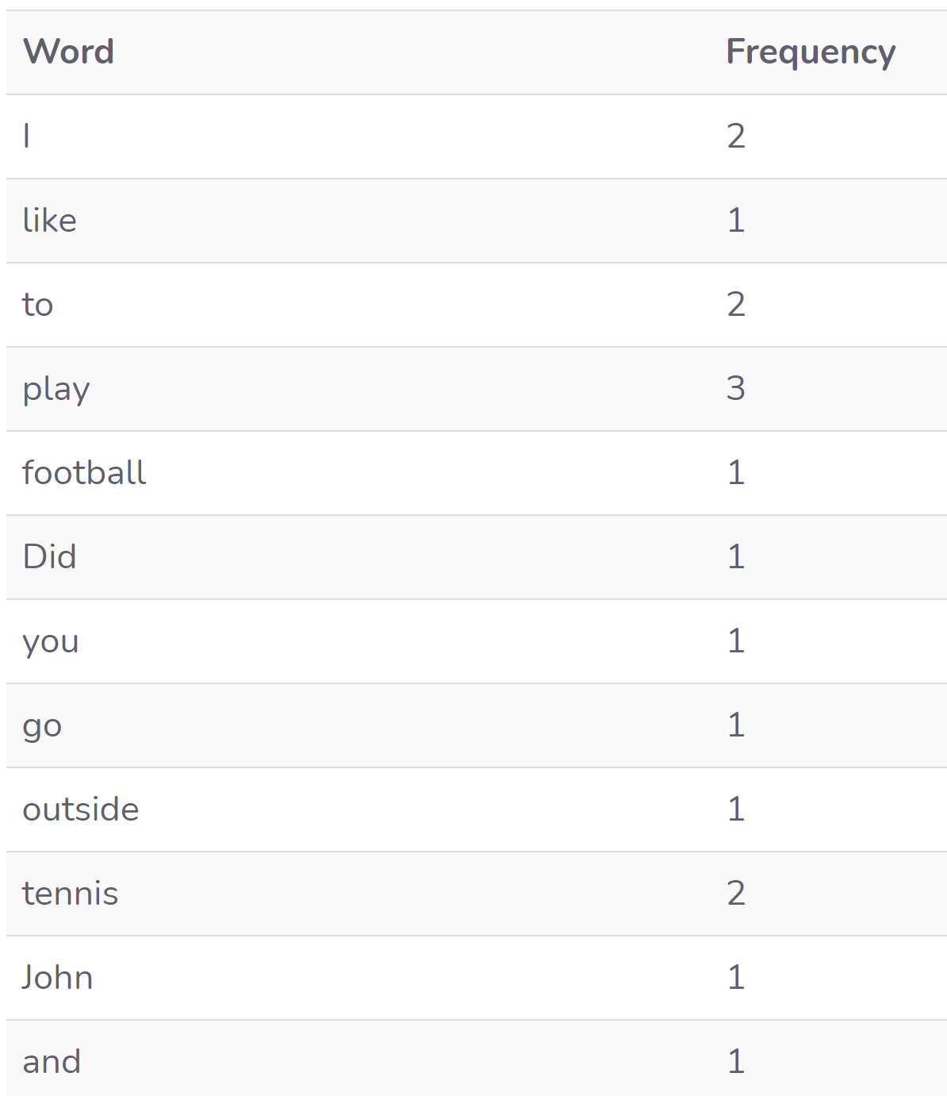
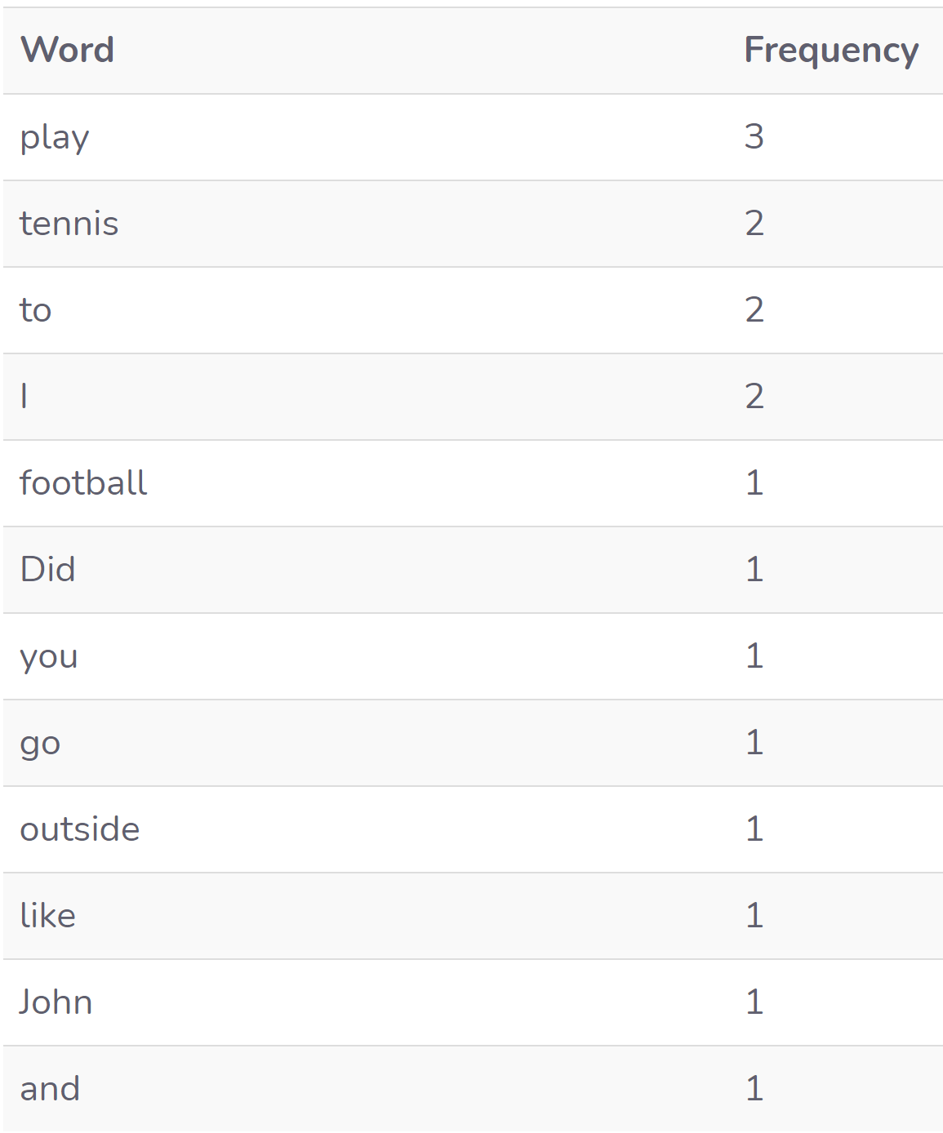
Bag of Words (cont…)
Step 2 : Create a Dictionary of Word Frequency
Create a dictionary that contains all the words in our corpus as keys and the frequency of the occurrence of the words as values.
Fig : Before sorting
Fig : After sorting (decreasing order)

Slide 26
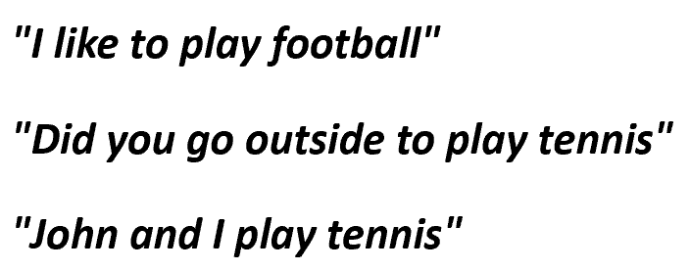
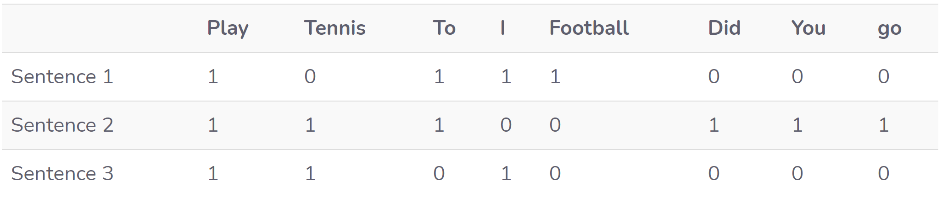
Bag of Words (cont…)
Step 3 : Creating the Bag of Words Model
To create the bag of words model, create a matrix where the columns correspond to the most frequent words in the dictionary where rows correspond to the document or sentences.
Suppose on considering the Bow model with the 8 most occurring words from the dictionary. Then the document frequency matrix will look like this:

Slide 27
Bag of Words (cont…)
Limitations
Semantic meaning: The basic BOW approach does not consider the meaning of the word in the document. It completely ignores the context in which it’s used. The same word can be used in multiple places based on the context or nearby words.
Vector size: For a large document, the vector size can be huge resulting in a lot of computation and time. You may need to ignore words based on relevance to your use case.
Notes:
https://www.freecodecamp.org/news/an-introduction-to-bag-of-words-and-how-to-code-it-in-python-for-nlp-282e87a9da04/

Slide 28
Term Frequency-Inverse Document Frequency (TF-IDF)
The scoring method being used above takes the count of each word and represents the word in the vector by the number of counts of that particular word. What does a word having high word count signify?
Let me explain, if a word occurs many times in a document but also along with many other documents in our dataset, maybe it is because this word is just a frequent word; not because it is relevant or meaningful
One approach is to rescale the frequency of words by how often they appear in all documents so that the scores for frequent words like “the” that are also frequent across all documents are penalized.
This approach is called term frequency-inverse document frequency or shortly known as TF-IDF approach of scoring
TF-IDF is intended to reflect how relevant a term is in a given document
TF-IDF for a word in a document is calculated by multiplying two different metrics:
TF-IDF = Term Frequency(TF) x Inverse Document Frequency(IDF)
Notes:
https://www.freecodecamp.org/news/how-to-process-textual-data-using-tf-idf-in-python-cd2bbc0a94a3/
https://www.mygreatlearning.com/blog/bag-of-words/

Slide 29
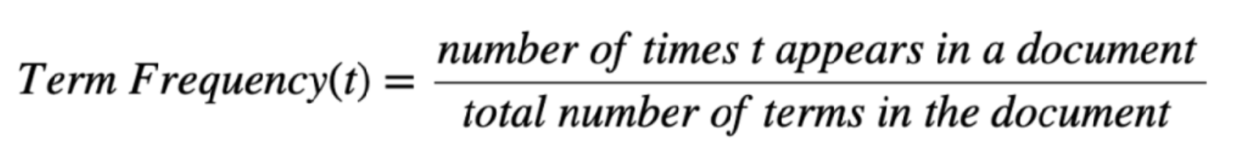
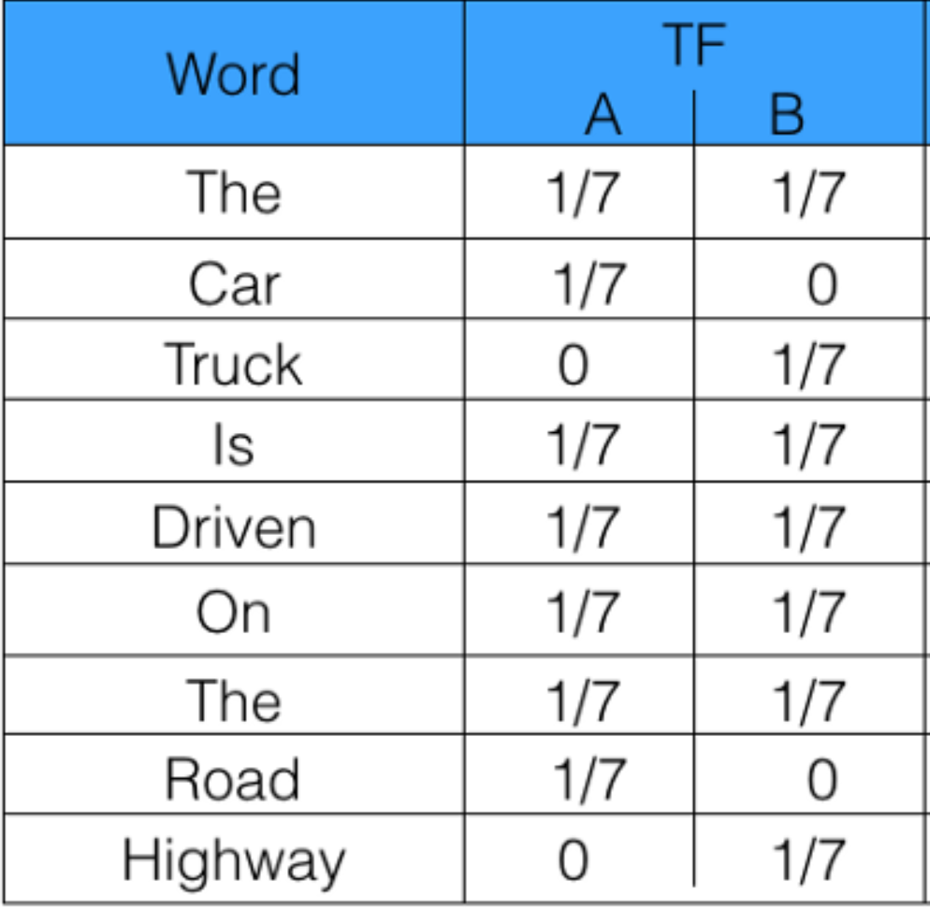
TF-IDF (cont…)
Term Frequency (TF)
Refers to the total number of times a given word/term ‘t’ appears in a document against the total number of all words in a document
It increases as the number of occurrences of a word/term within the document increases. Each document has its own term frequency.
Let’s take an example to get a clearer understanding
Sentence 1 : The car is driven on the road.
Sentence 2: The truck is driven on the highway.

Slide 30
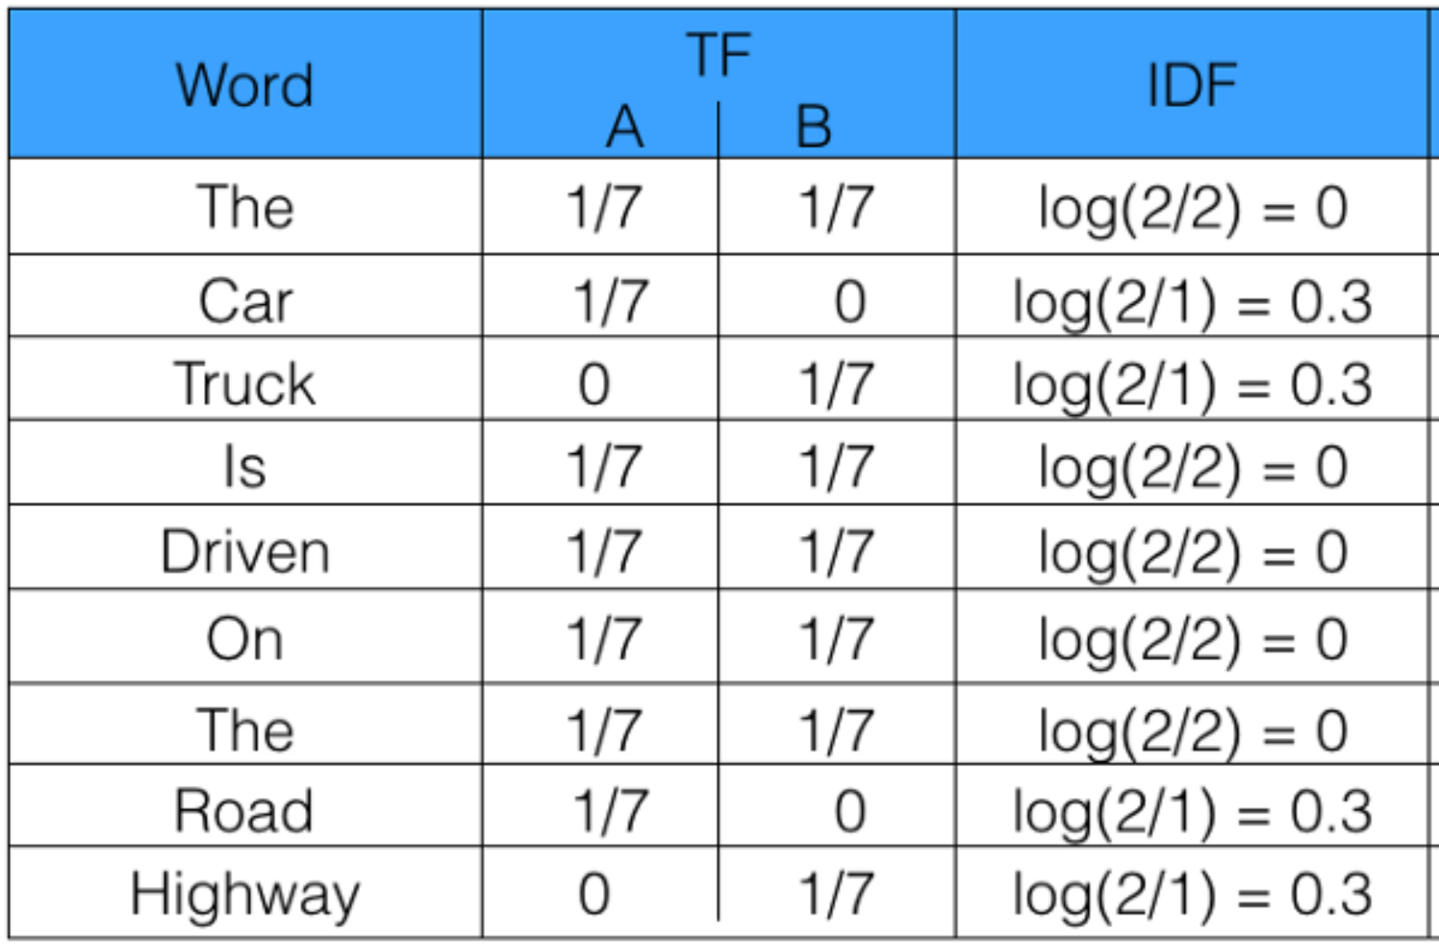
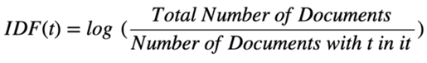
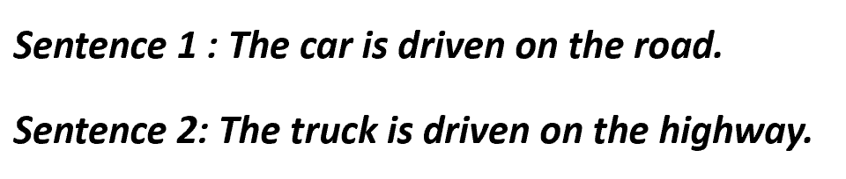
TF-IDF (cont…)
Inverse Document Frequency (IDF)
It is used to calculate the weight of rare words across all documents in the corpus. The words that occur rarely in the corpus have a high IDF score.
So, if the word is very common and appears in many documents, this number will approach 0. Otherwise, it will approach 1.
It is given by
Notes:
https://medium.com/@hritikattri10/feature-extraction-using-tf-idf-algorithm-44eedb37305e

Slide 31
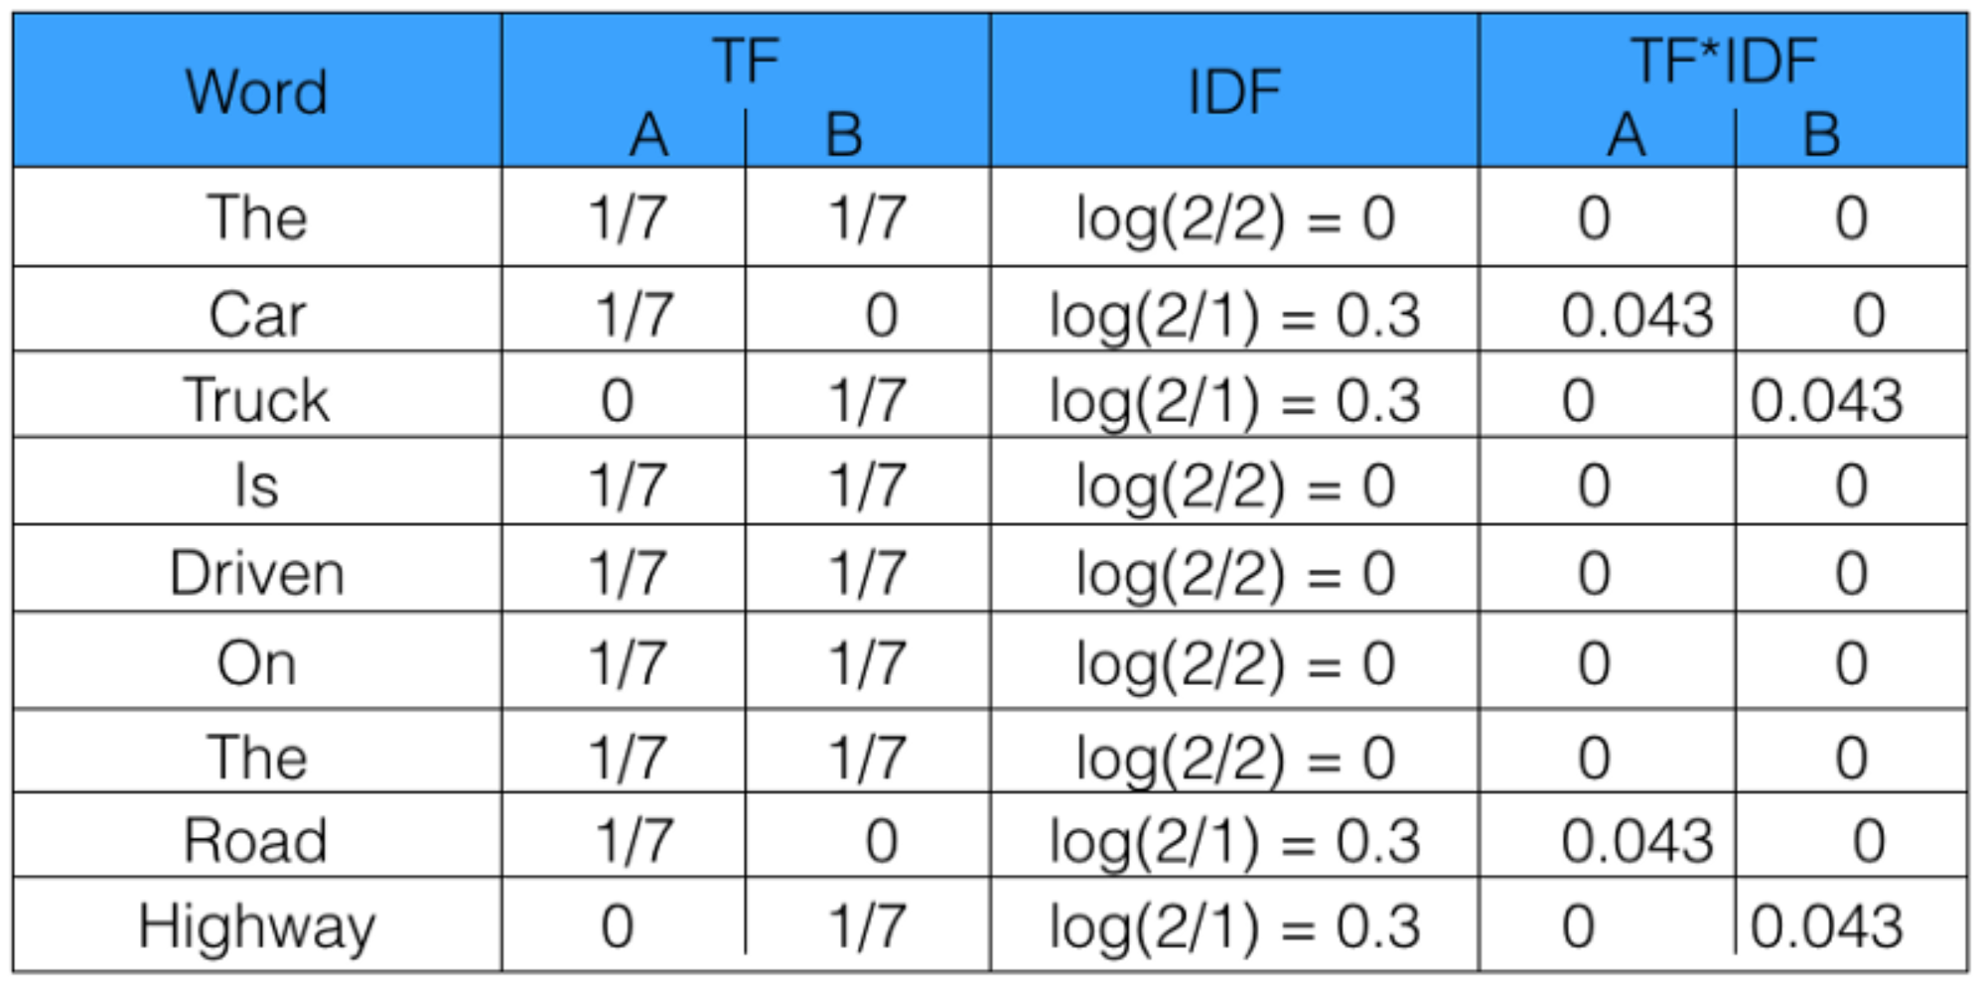
TF-IDF (cont…)
Term Frequency - Inverse Document Frequency (TF-IDF)
Finally, the product of TF and IDF will give us a measure of how frequent the word is in a document multiplied by how unique the word is, giving rise to Term Frequency-Inverse Document Frequency(TF-IDF) measure.
TF-IDF = TF x IDF
Notes:
https://www.freecodecamp.org/news/how-to-process-textual-data-using-tf-idf-in-python-cd2bbc0a94a3/

Slide 32
Naïve Bayes Classifier
A Naive Bayes classifier is a probabilistic machine learning model that’s used for classification task i.e. to discriminate different objects based on certain features.
It assumes that the presence of a particular feature in a class is unrelated to the presence of any other feature.
Bayes Theorem can be stated as P(A|B) = P(B|A) * P(A) / P(B) ( Posterior = Likelihood * Prior / Evidence)
where P(A|B): Posterior probability, P(A): Prior probability, P(B|A): Likelihood, P(B): Evidence
For example, a fruit may be considered to be an apple if it is red, round, and about 3 inches in diameter. Even if these features depend on each other or upon the existence of the other features, all of these properties independently contribute to the probability that this fruit is an apple and that is why it is known as ‘Naive’.
Notes:
https://towardsdatascience.com/naive-bayes-classifier-81d512f50a7c
https://machinelearningmastery.com/bayes-theorem-for-machine-learning/
https://www.analyticsvidhya.com/blog/2017/09/naive-bayes-explained/

Slide 33
Implementing Naïve Bayes for Text Classification
Naive Bayes is a learning algorithm commonly applied to text classification.
Some of the applications of the Naive Bayes classifier are:
Classification of emails
Tagging of job listings
Categorization of products
To build a Naive Bayes classifier let’s follow the below simple steps:
Step 1 : Identify the prerequisites to train a Naive Bayes classifier
Step 2 : Computing the Term-Document Matrix (TDM) for each class
Sept 3 : Compute frequencies
Step 4 : Recall the Naive Bayes rule
Step 5 : Compute the probability of an incoming email being Spam or Ham
Now let’s see how to Naïve Bayes Classifier can be used to classify the incoming emails as “spam” or “ham”
Notes:
https://towardsdatascience.com/implementing-a-naive-bayes-classifier-for-text-categorization-in-five-steps-f9192cdd54c3

Slide 34
Generic Evaluation Metrics for Classification Models
Evaluation of the performance of a classification model is based on the counts of test records correctly and incorrectly predicted by the model.
The metrics that you choose to evaluate the machine learning model is very important. Choice of metrics influences how the performance of machine learning algorithms is measured and compared.
Let’s jump right in and see what are the various metrics available
Confusion Matrix
Accuracy
Precision
Recall or Sensitivity
Specificity
F1 Score
ROC Curves & Precision-Recall Curves

Slide 35
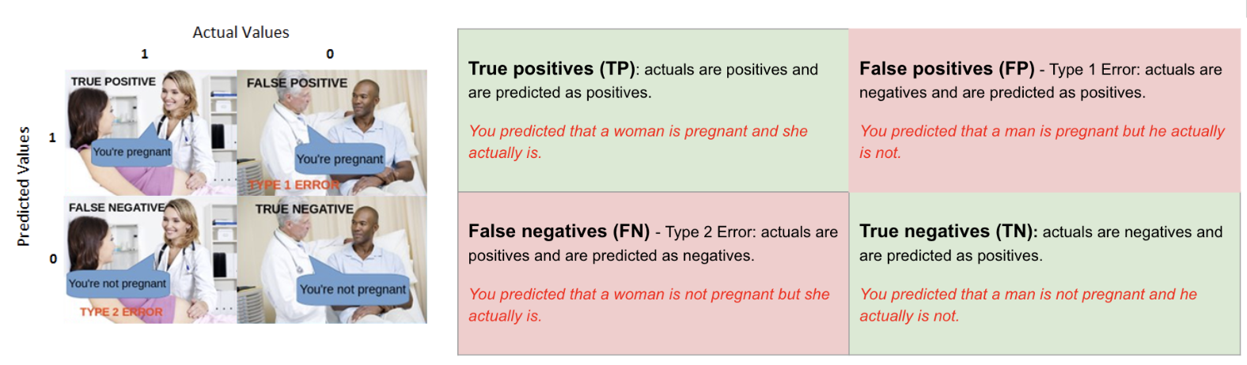
Metrics (cont…)
Confusion Matrix
The Confusion matrix is one of the most intuitive and easiest (unless of course, you are not confused)metrics used for finding the correctness and accuracy of the model.
It is used for classification problem where the output can be of two or more types of the below classes
True Positives (TP) / True Negatives (TN) / False Positives (FP) / False Negatives (FN)
Notes:
https://www.kdnuggets.com/2020/04/performance-evaluation-metrics-classification.html

Slide 36
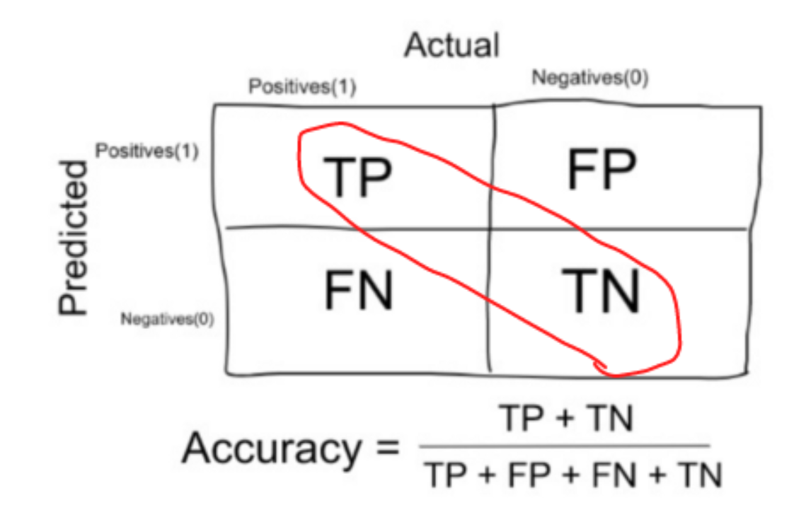
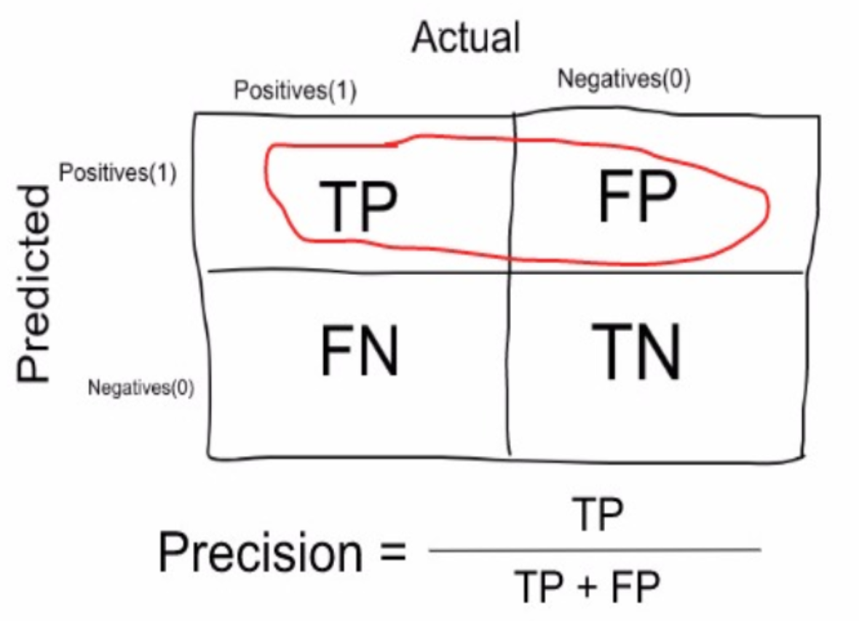
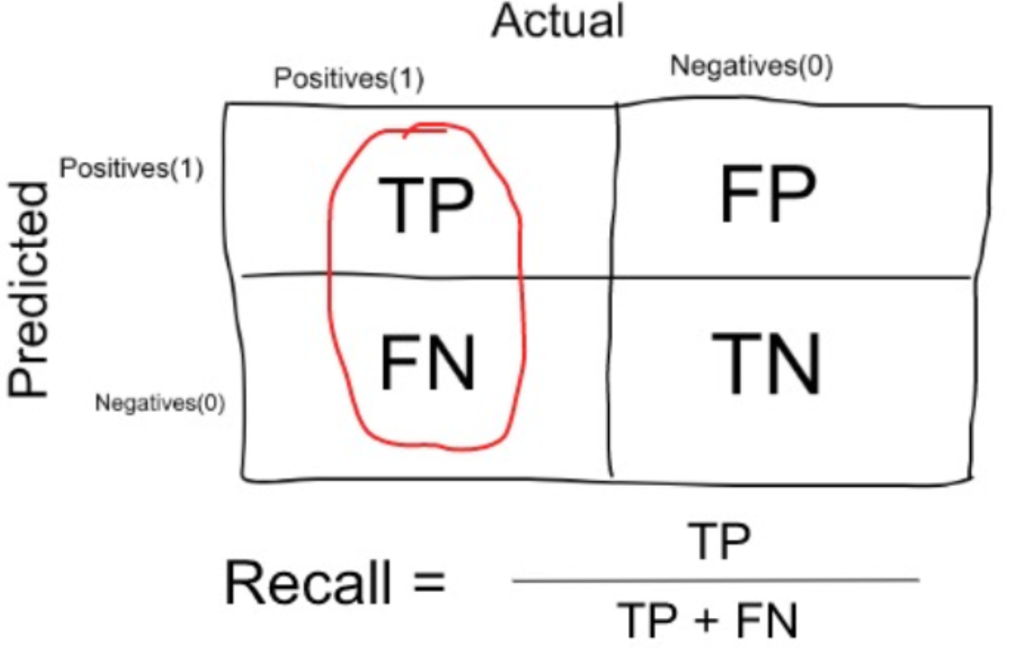
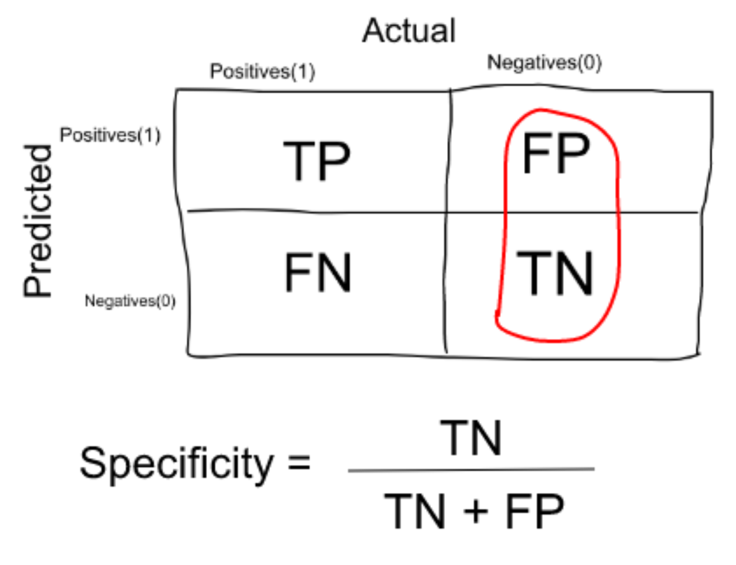
Metrics (cont…)
Accuracy / Precision / Recall(Sensitivity) / Specificity
Accuracy is simply a ratio of correctly predicted observation to the total observations
Precision is how much were correctly classified as positive out of all positives
Recall(Sensitivity) is the ratio between how much were correctly identified as positive to how much were actually positive
Specificity is the ratio between how much were correctly classified as negative to how much was actually negative
When to prioritize Recall over Precision?
Recall should be optimized over precision when there is a high cost associated with a False Negative, i.e. system predicts benign when tumor is in fact malignant.
When to prioritize Precision over Recall?
Precision should be optimized over recall when there is a high cost associated with a False Positive, i.e. spam detection.
Notes:
https://medium.com/@MohammedS/performance-metrics-for-classification-problems-in-machine-learning-part-i-b085d432082b
https://www.kdnuggets.com/2020/04/performance-evaluation-metrics-classification.html
https://towardsdatascience.com/the-5-classification-evaluation-metrics-you-must-know-aa97784ff226
https://lawtomated.com/accuracy-precision-recall-and-f1-scores-for-lawyers/

Slide 37
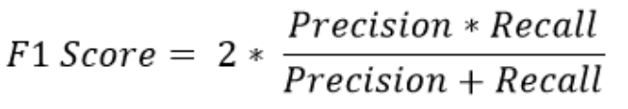
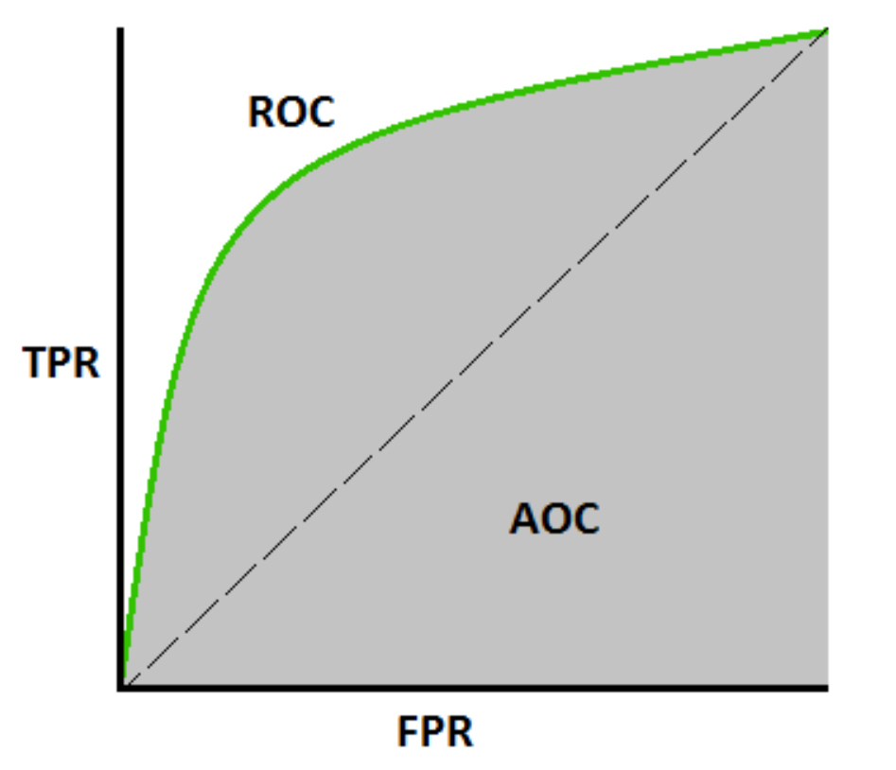
Metrics (cont…)
F1 Score
It’s a measure much better than Accuracy.
Both Precision and Recall are very important, instead of trying on balancing out, we compute harmonic mean i.e. F1 Score
Generally, we aim for a good F1-score and that would be indicative of a good Precision and a good Recall value as well.
ROC Curves & Precision-Recall Curves
Along with the above terms, there are more values we can calculate from the confusion matrix.
When it comes to classification problems, we need to count on
AUC(Area Under the Curve)-ROC (Receiver Operating Characteristic) curve
PRC (Precision-Recall) curve
ROC is the plot between the TPR(y-axis) and FPR(x-axis)
False Positive Rate (FPR): is the ratio of the False Positives to the Actual number of Negatives
True Negative Rate (TNR) or the Specificity: is the ratio of the True Negatives and the Actual Number of Negatives. If ‘X’ is FPR, then TNR = 1 – FPR
Precision-Recall Curve (PRC) is a direct representation of the precision(y-axis) and the recall(x-axis)
Notes:
ROC Curves
https://www.analyticsvidhya.com/blog/2020/09/precision-recall-machine-learning/
https://towardsdatascience.com/understanding-auc-roc-curve-68b2303cc9c5

Slide 38
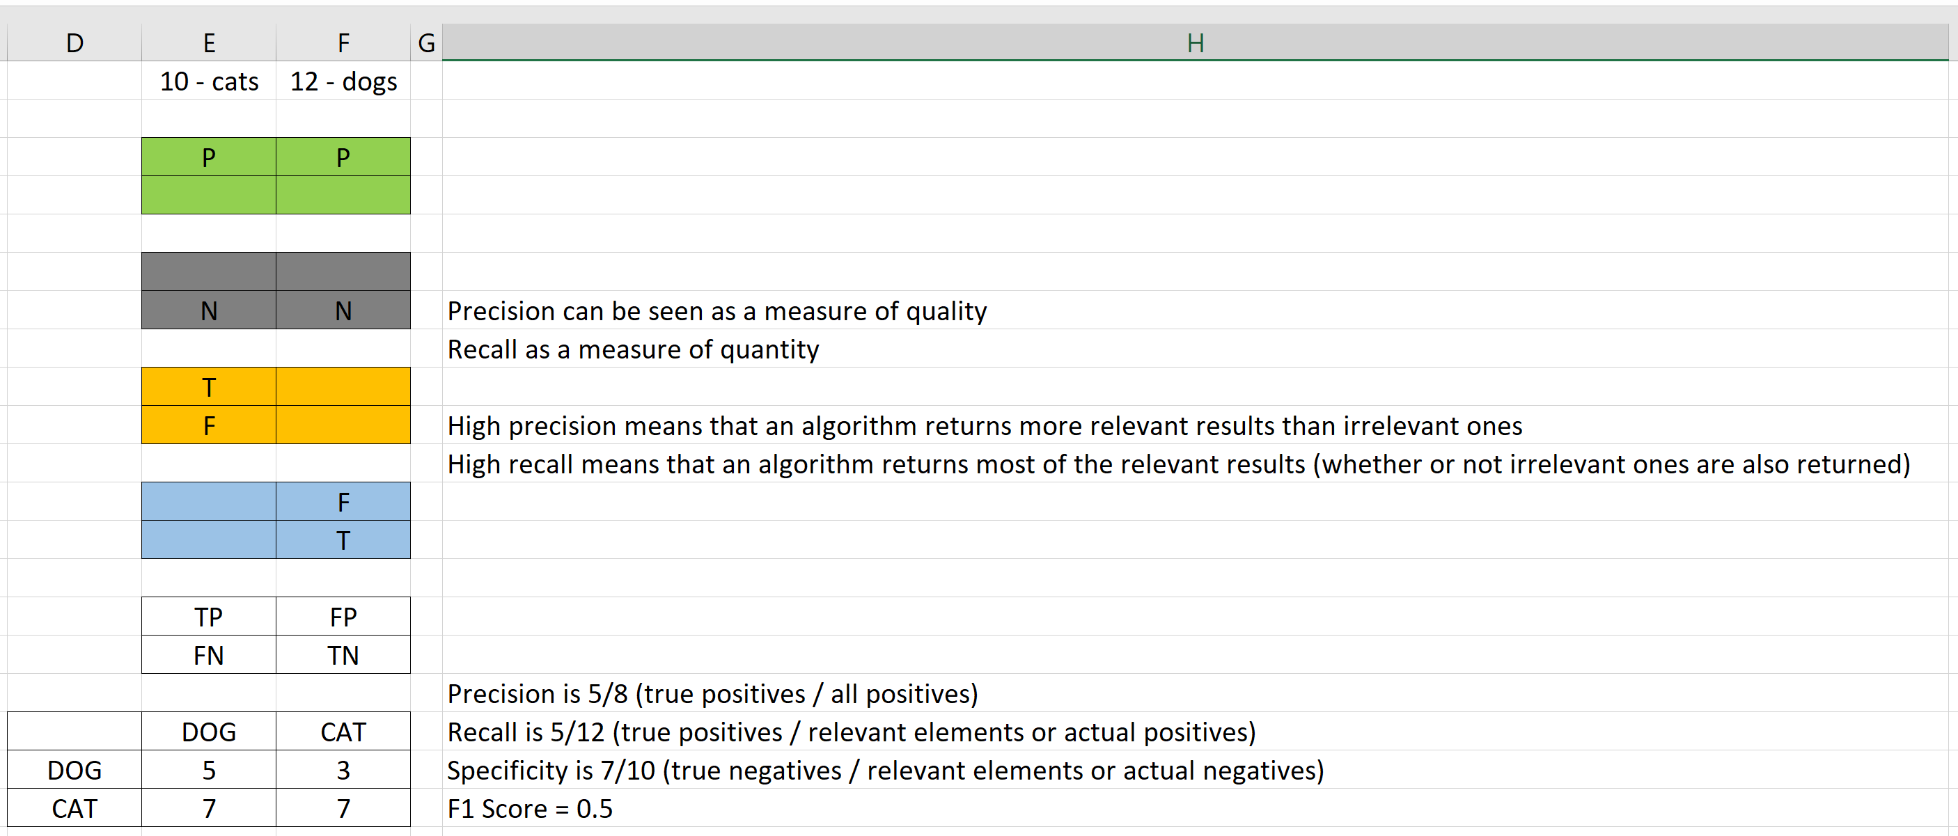
Metrics (cont…)
Actual
Predicted
Notes:
https://en.wikipedia.org/wiki/Precision_and_recall

Slide 39
Evaluation Metrics for NLP/Text Generation Models
Similarity Metrics (Cosine, Jaccard, etc…)
Word Error Rate
BLEU (Bilingual Evaluation Understudy) Score
used to compare models in the NLG domain i.e. used to evaluate translations from one language to another
is a PRECISION focused metric that calculates overlap of the reference and generated texts
Rouge (Recall Oriented Understudy for Gisting Evaluation)
used to compare models in the NLG domain i.e. used to evaluate translations from one language to another
is a RECALL focused metric that calculates overlap of the reference and generated texts
Perplexity
a commonly used metric for evaluating the efficacy of generative models
is used as a measure of probability for a sentence to be produced by the model trained on a dataset
lower the perplexity value, the better the model
Latent Semantic Analysis (LSA)
is used to calculate the semantic similarity of two texts based on the words they both contain
uses word co-occurrence counts from a large corpus, that is pre-computed
doesn’t look much into word choice variation as much i.e this metric is lenient on “good” and “nice”, whereas rouge and bleu would not be
METEOR (Metric for Evaluation of Translation with Explicit Ordering)
is an uncommon metric that works on word alignments
computes one to one mapping of words in generated and reference texts
is a relatively lesser used metric in NLG, especially since the take-off of deep learning models
TER (Translation Edit Rate)
works on the principle of conversion of the generated text to the target text
is a measurement of the absolute dissimilarity between the strings by counting the number of operations required to transform one string into another
Notes:
https://towardsdatascience.com/how-to-evaluate-text-generation-models-metrics-for-automatic-evaluation-of-nlp-models-e1c251b04ec1
https://medium.com/fintechexplained/nlp-how-to-evaluate-the-model-performance-7e1820cdb759
https://towardsdatascience.com/evaluation-of-an-nlp-model-latest-benchmarks-90fd8ce6fae5

Slide 40
INTRODUCTION

Slide 41
https://www.kaggle.com/sudalairajkumar/getting-started-with-text-preprocessing
https://www.kaggle.com/saxinou/nlp-01-preprocessing-data
Bag of words & tf-IDF
https://www.mygreatlearning.com/blog/bag-of-words/
https://www.analyticsvidhya.com/blog/2020/02/quick-introduction-bag-of-words-bow-tf-idf/

Slide 42
tf-idf
https://monkeylearn.com/blog/what-is-tf-idf/
https://towardsdatascience.com/natural-language-processing-feature-engineering-using-tf-idf-e8b9d00e7e76
https://medium.com/analytics-vidhya/tf-idf-term-frequency-technique-easiest-explanation-for-text-classification-in-nlp-with-code-8ca3912e58c3
https://stackabuse.com/python-for-nlp-creating-tf-idf-model-from-scratch/

